Slide 1
Libraries
JavaScript

Slide 2
What is a library?
A library can consist of anything that one might reference in their software to add templating, sets of classes or functions, configuration data, or any pre-written code that may help with the program being written.
In JavaScript, we usually see libraries as a pre-written class or set of functions that help us get a particular task done a lot quicker than our trying to write it on our own.
Why reinvent the wheel, if someone’s already solved the problem!? When you need a solution to something stumping you, always have a look around to see if there is a stable library available.
Some of the more popular libraries in JavaScript for use in your website(s) include…
Axios: Simplified promise-based ajax requests.
React: Intended for use in developing modular user interfaces via “components.”
Luxon: Simplified date and time manipulation.
Popper: Tooltip and in-page pop-up positioning.
Cleave.js: Form field formatting.
Anime.js: CSS and SVG animations.
Three.js: 3D animation in the browser.
jQuery: Simplified DOM tree traversal and additional utility methods; plugin support.

Slide 3
Installing a Library in your Project
There are a couple of ways that libraries are usually included in a web project:
Manual Installation
Import
It is important to remember that, and the end of the day, a library is going to just be pre-written JavaScript code for you to use or build on.
If we’re going with the manual installation route, this means simply including a JavaScript file and adding a <script> element into our HTML to read from it.
The important thing here will be the order in which the files are loaded. If the program you’re writing needs to use a function or class from the library you’re using, the library must be loaded first.
By loading the library into your webpage first (the <script> element with the library “src” appears first in the page) any code you write that loads afterwards will be able to call upon those functions, classes, etc.
Order often matters; consider it when adding anything to your projects!

Slide 4
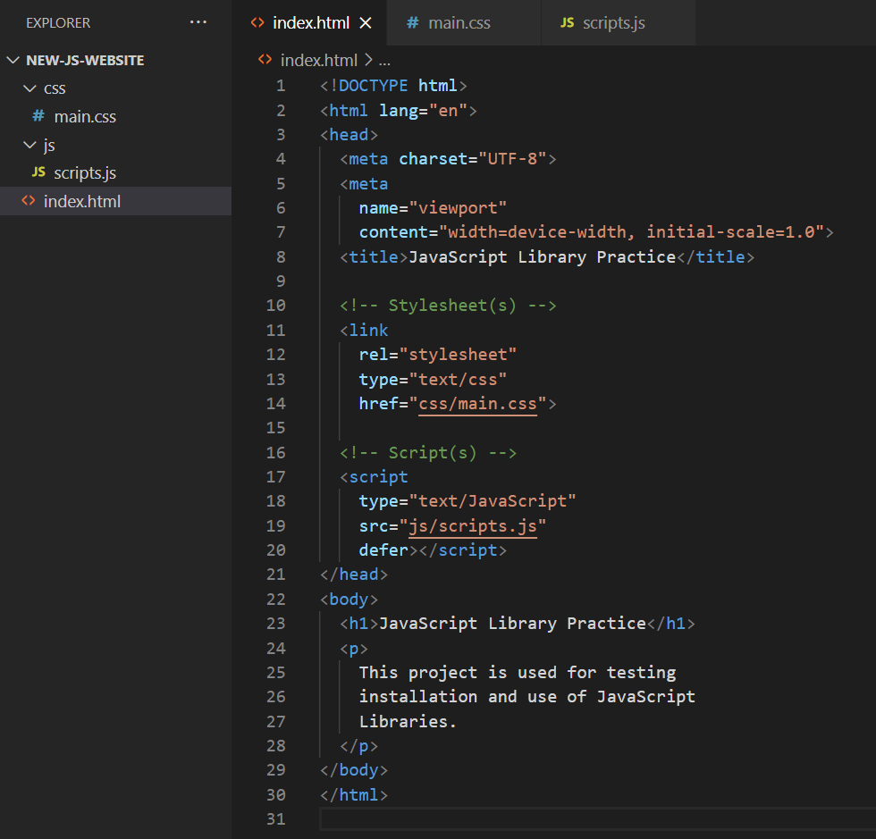
Start a Website; Let’s Try Installing a Library
Create a basic project with an HTML file and JS file, that we can use for our experiments.

Slide 5
Selecting a Library
Now to pick a library we’d like to install within our project. There are a number of things you should consider before deciding to use a library:
Does the problem I’m solving warrant the installation of a library?
Which libraries are available to assist in this endeavour?
How large is the library? The larger filesize(s), the longer the download will take for website visitors.
How well-documented is the library? If they do not have instructions, it may take too long to learn or reverse-engineer for it to be viable.
How popular is the library? See if there are a lot of downloads of this software, check to see that people are actively asking questions and talking about it.
How new or updated is the library? Ensure that it is mature and that it has been updated. It can be equally risky to try something invented today as it might be to try something that was last updated eight years ago. You want something reliable and established.
What sort of licence or usage rights are available? Different software has different rules about how it can be used. Keep an eye out to see if it costs money, or has a limited-use licence of some kind.

Slide 6
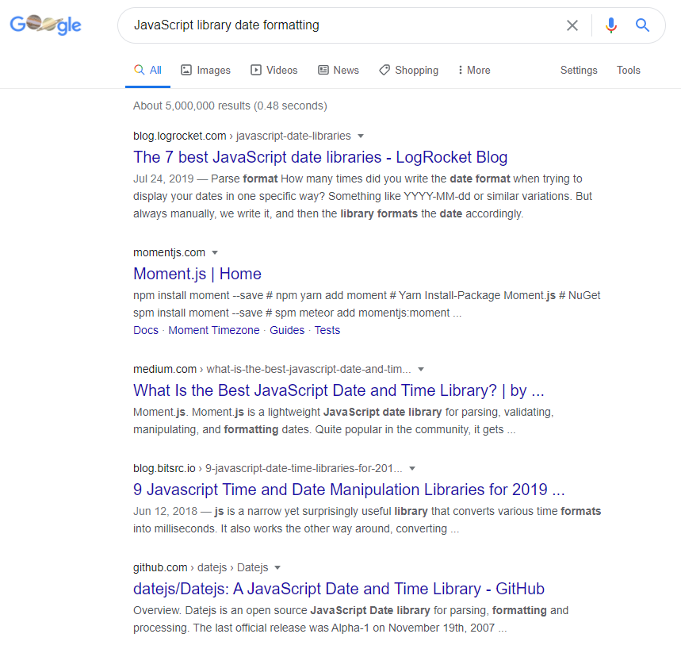
Where can we Find Answers to these Questions?
If you have a problem in mind you are trying to solve, the search often starts with Google. Say we want to be able to very quickly and easily format dates as human-readable strings… we might search “JavaScript library date formatting”.
In your results for a search like this, you may see a mix of official websites for libraries among “The X Best Libraries for Y!” articles. Both are worth having a look at! The great thing about those articles is they’ll often list pros and cons for what is available (make sure to check that the article is recent, though—outdated data isn’t as reliable!)
Let’s say we were interested in trying to answer our list of questions regarding what’s covered in this result.

Slide 7

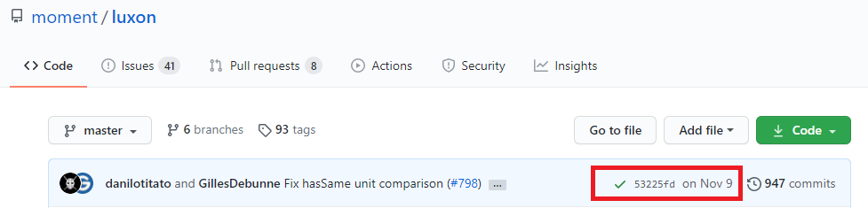
Reading is Important
At a glance, Moment.js sounds like the correct answer, it was a result and spoken of highly in the article. It is old but updated, mature, tried, and true. Visiting their website and reading their documentation, however, paints a picture that may give you a different perspective. They recommend trying an alternative that uses more modern and efficient techniques.
Alright, so they actually recommend Luxon—a modern replacement for Moment.js. If we visit that website, we can look at our questions again. Here’s some info we can gleam from their website and GitHub repository…
File size? 68.8 KB minified; this is very fair!
Well-documented? Yes!
Popular? Visit the GitHub repository—it has a healthy number of watches, stars, and forks. There is frequent discussion and help.
Updated frequently? Yep!
Licence? MIT Licence; free to use and modify, copyright preserved though!

Slide 8
Readying for Installation
It is always a good idea to check the documentation for the library for installation instructions. They’ll often point you toward the most optimal methods available for including and using it in your project.
For best download speed of your final website for your website visitors, it is best to check for a minified version of the code source. Minified code is code with all unnecessary characters removed—sometimes things like variable names will be shortened as well, to conserve file size. Thankfully, Luxon provides a minified version right out of the box, so we don’t have to worry about trying to do that on own!
To help communicate that code has been minified, you’ll often see it renamed to end in “.min.js”. This tells other developers (and yourself) that this code has already been crunched down to the minimum possible size, which is optimum for the production (launch) environment.
You’ll want to download the minified file (or any required files as per the installation instructions) to your computer for inclusion in your project.

Slide 9
Structuring your Project
In most web projects you’ve worked on thus far, you’ve probably set up the files and folders similarly to the following…
css
main.css
js
scripts.js
img
(image files)
Index.html
This is great for the files we’ve worked on thus far! However, when including libraries, it is recommended we add a new folder called “vendors.”
This is not a hard and fast rule, perse, but it is important you have a reliable way to communicate which parts of your project are original, and which are library and framework add-ons. This folder might end up looking something like the following, to help you keep organized…
vendors
luxon
luxon.min.js
licence.md
other-larger-library
js
Other-library.min.js
css
other-library.min.css
licence.md
Notes:
Note that depending on the team you work with or company rules and guidelines, you may be expected to use a different file/folder structure!

Slide 10
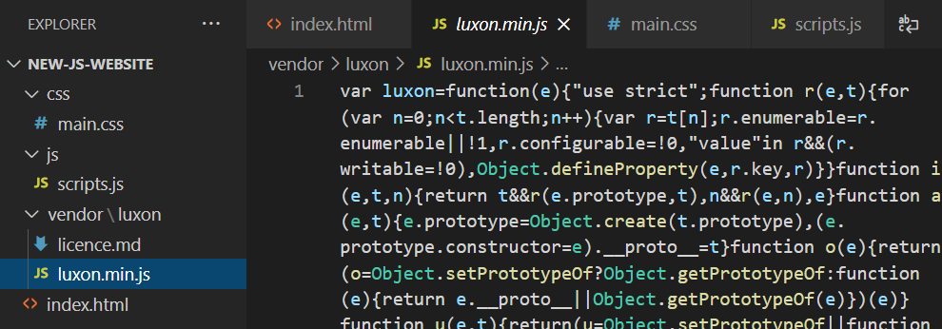
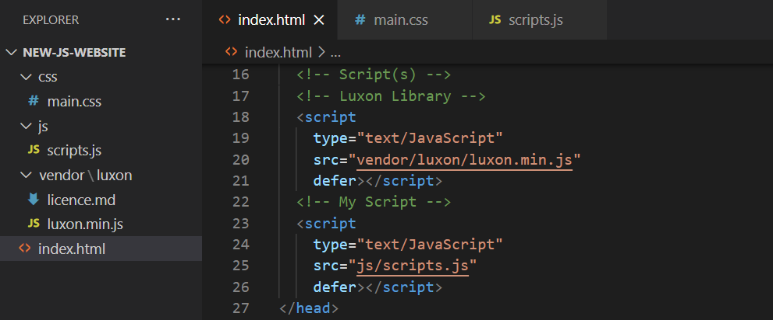
Installing Luxon in your Project
Remember: order matters; if we want to be able to use Luxon in our script, we’ll need to ensure it is loaded into the page first!
Download the minifed version of the project, and include a new <script> element in your page that references it.

Slide 11
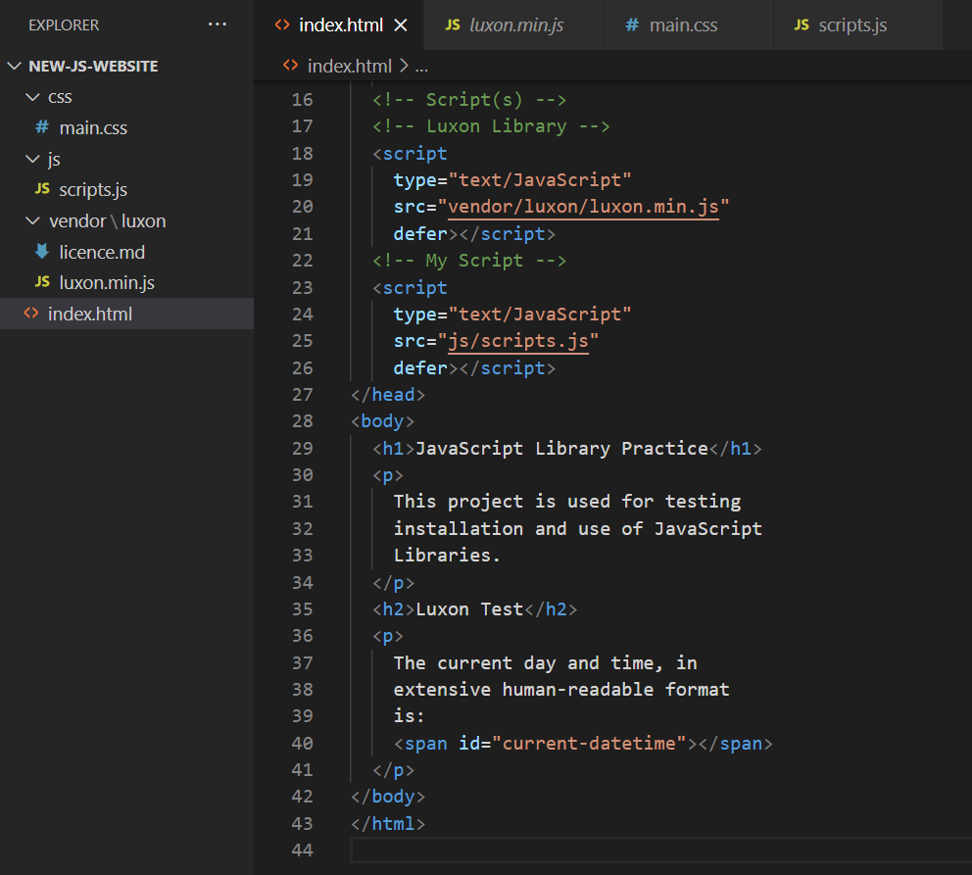
Preparing for Output
To ensure it is working properly, check for errors in the Web Console. If it is all clear, try some code that uses the library!
For the sake of our example, the problem was date formatting. Let’s see if this library will format a date for us, or if we made a mistake in our installation.
Add a bit more HTML so that we can easily output results into the browser.
Notes:
<!DOCTYPE html>
<html lang="en">
<head>
<meta charset="UTF-8">
<meta
name="viewport"
content="width=device-width, initial-scale=1.0">
<title>JavaScript Library Practice</title>
<!-- Stylesheet(s) -->
<link
rel="stylesheet"
type="text/css"
href="css/main.css">
<!-- Script(s) -->
<!-- Luxon Library -->
<script
type="text/JavaScript"
src="vendor/luxon/luxon.min.js"
defer></script>
<!-- My Script -->
<script
type="text/JavaScript"
src="js/scripts.js"
defer></script>
</head>
<body>
<h1>JavaScript Library Practice</h1>
<p>
This project is used for testing
installation and use of JavaScript
Libraries.
</p>
<h2>Luxon Test</h2>
<p>
The current day and time, in
extensive human-readable format
is:
<span id="current-datetime"></span>
</p>
</body>
</html>

Slide 12
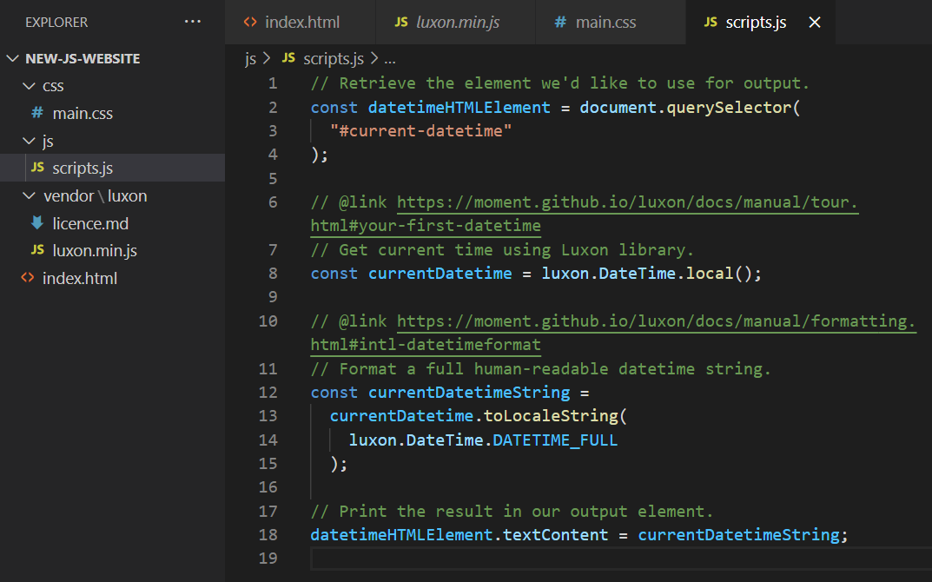
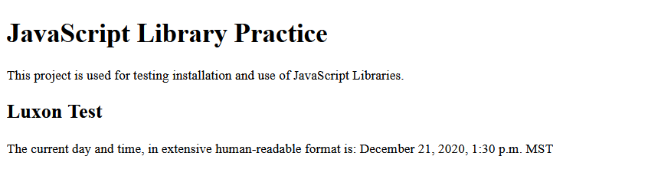
Using Luxon
Read up on how to format dates using the library, and give it a shot!
Let’s try writing some code that makes use of the class(es) Luxon provides.
Notes:
What other formats do you see in the documentation? Do you think this library may be useful for you in the future?
// Retrieve the element we'd like to use for output.
const datetimeHTMLElement = document.querySelector(
"#current-datetime"
);
// @link https://moment.github.io/luxon/docs/manual/tour.html#your-first-datetime
// Get current time using Luxon library.
const currentDatetime = luxon.DateTime.local();
// @link https://moment.github.io/luxon/docs/manual/formatting.html#intl-datetimeformat
// Format a full human-readable datetime string.
const currentDatetimeString =
currentDatetime.toLocaleString(
luxon.DateTime.DATETIME_FULL
);
// Print the result in our output element.
datetimeHTMLElement.textContent = currentDatetimeString;

Slide 13
Import
And that was using a feature from a library! We encourage you to continue exploring what Luxon (or any library) offers, as this was just scratching the very surface of one feature.
Earlier we had mentioned that there was the traditional, manual, way of installing a library as well as the newer import way of doing things.
The import keyword was introduced in ES6, and Luxon is nice enough to provide installation instructions if you’re following this standard as well!
The full list of ways that the import keyword can be used are described in great detail by the MDN docs, but for our purposes here we’ll only need to know one or two of the available syntaxes.
We just require the DateTime piece of the Luxon source code, so we can get away with using…
import { DateTime } from “vendor/js/luxon”’;
Using the import keyword replaces the need for having multiple <script> calls in your HTML. A single JavaScript file can call upon all required dependencies on its own this way.
Notes:
If your file starts with the addition of “import { DateTime } from “vendor/js/luxon”’;”, you won’t need to include the additional <script> and source in your HTML. This will make DateTime available by name in the rest of your document (assuming that your import was successful.) Note that we don’t need to mention the file extension/type “.js” in our import instructions.
The import feature is incredibly common in Node.JS (back-end programming with JavaScript) projects, or any projects that use a package/library manager program like NPM or Yarn in combination a module bundler solution like Webpack or Gulp. Webpack and Gulp can be used to combine all JavaScript project files into one, and even minify the combined file for you if you’d like. They know which file(s) and the order to include them based on imports—which there may be many of in larger projects.
Note that this can be difficult to test when using the file:// protocol (loading files from your local computer) as the CORS protection feature in most browsers won’t allow much, if any, crawling of your filesystem by web browsers to protect you and your data.

Slide 14
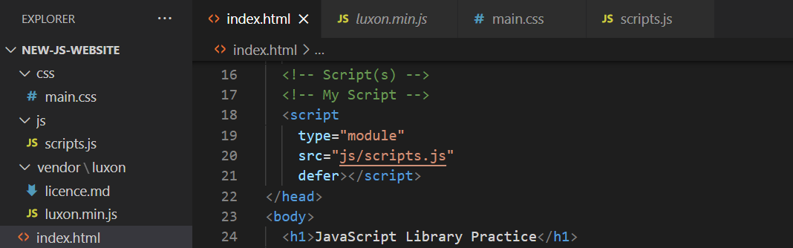
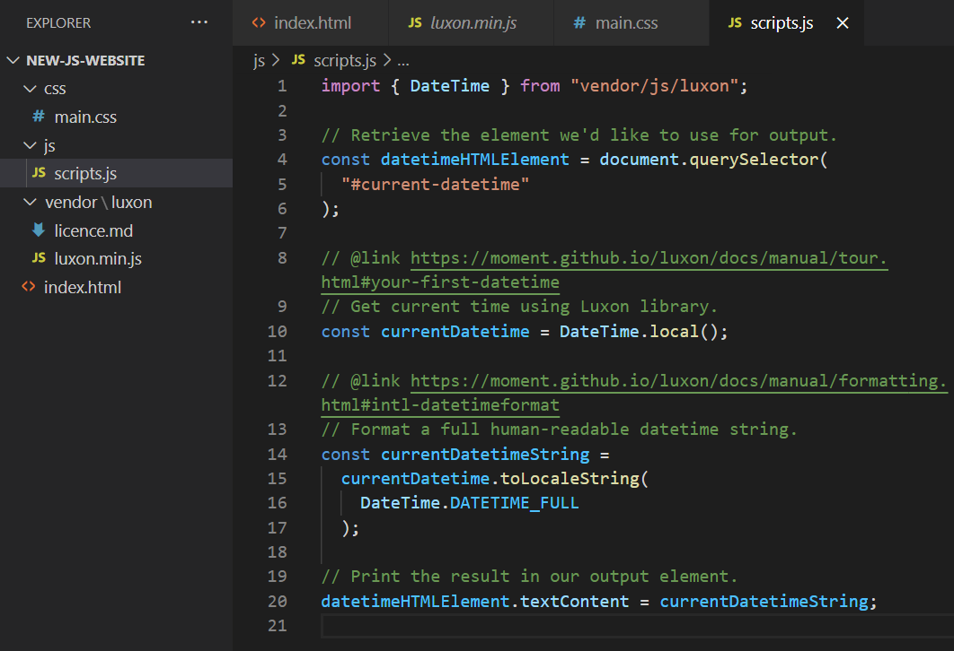
Using Import
Remove the <script> that referenced Luxon; add type=”module” to your original <script> element; and update your scripts.js file accordingly.
Notes:
On local this won’t work as expected due to the origin (file://, your personal PC) being protected. If hosted (either on a local server or on a real online public server), this solution should be just fine though!

